Slide 1
EVENT MANAGEMENT SYSTEM
Faculty :Dr. Jagadeesh G Submitted By
13mse0220(Yamini.S)
13mse0204(Sajad Akram)

Slide 2
.
INTRODUCTION
It enables the user to create from a list of types of events. Once the user enters the type of event (such as a workshop, hands on session, lecture, etc.), and the system then allows the user to specify the event details. Then send this data to the administrator (site owner), they may interact with the client according to their needs and Clients may also interact with the oraganizer according to their needs. The Events details will be displayed in the website. Students those who want to see the details of events can see it in the home page

Slide 3
ABSTRACT
This project is an Event Management System software on the Internet that serve the function of the event manager. This System only allows users to log in and allowed new users to register on the application only with username and password. This is an advanced web application in PHP and SQL. The project provides most of the basic functions needed for this event management system. It enables the user to create from a list of types of events. Once the user enters the type of event (such as a workshop, hands on session, lecture, etc.), and the system then allows the user to specify the event name, date and time of the event and the place and event equipment. The registration of all these data takes place in the database and the user is given a login and password to modify the event details. Then send this data to the administrator (site owner), they may interact with the client according to their needs and contact data stored in the database. Clients may also interact with the oraganizer according to their needs and contact data stored in the database. The Events details will be displayed in the website. Students those who want to see the details of events can see it in the home page.

Slide 4
SOFTWARE AND HARDWARE REQUIREMENT
SOFTWARE REQUIREMENTS:
The Software requirements include the frontend programming [PHP] and the backend database system[SQL]. The application should be easy to use, and it should be easily managed by any person with little knowledge of computers. The database should be easy to install and configure. At the same time it should be portable and independent so that we can use the database anywhere and install it on any laptop or PC. This application should be very easy to install on any machine. Finally, this application should not require higher configuration on any machine

Slide 5
CONCLUSION
In this dissertation we have studied different management systems used during evaluation and presented a low cost event management system application with the help of that study. A survey was also conducted to get current needs of small businesses which could be willing to migrate to the Mobile Phone Event Management System application. The implementation of this system as a single solution for different colleges was challenging. I have learned a lot about document writing during this progression. The process of writing thesis document, which is a research paper, was not familiar to me, but of great benefit. The application Event Management System is created to help students to transfer their records from paper-based system to computerized system, even with a low budget. At the same time, the requirements of a basic events have been taken care of, and a few features that can make the application easier to use and easy to understand to the user with beginner level knowledge of computers have been added. I hope that Event Management System fulfills all basic requirements for managing eveents with intention of transferring to computerized system. The survey of real Event Management System helped me to understand current practice, and possible needs.

Slide 6
CONFIGURATION CONCEPTS OF THE SOFTWARE Configuration Identification i) The system then allows the user to specify the event name, date and time of the event and the place and event equipment. ii) The user is given a login and password to modify the event details. iii) Then send this data to the administrator (site owner), they may interact with the client according to their needs and contact data stored in the database. iv) Clients may also interact with the oraganizer according to their needs and contact data stored in the database.

Slide 7
Configuration Control Event management is the application of project management to the creation and development of large scale events such as festivals, conferences, ceremonies, formal parties, concerts, or conventions. It involves identifying the target audience, devising the event concept, planning the logistics and coordinating the technical aspects before actually launching the event.

Slide 8
Status Accounting The process of planning and co-ordinating the event is usually referred to as event planning and can include budgeting, scheduling, site selection, acquiring necessary permits, coordinating transportation and parking, arranging for speakers or entertainers, arranging event security, catering and emergency plans.

Slide 9
Audit and Reviewing The application Event Management System is created to help students to transfer their records from paper-based system to computerized system, even with a low budget. At the same time, the requirements of a basic events have been taken care of a few features that can make the application easier to use and easy to understand to the user with beginner level knowledge of computer.

Slide 10
Advantage of using Configuration Concepts >The complexity reduced from nature of the product >The interfaces between activities directly involved in the configuration management process. >The other relevant interested person’s they may be involved, within and outside the organization. >The identification of the responsible authority for verifying implementation activities.

Slide 11
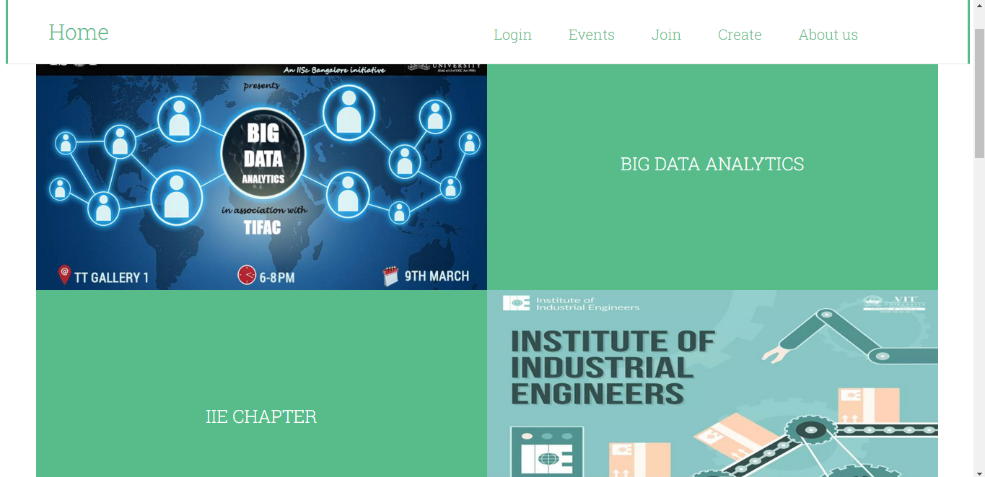

Slide 12
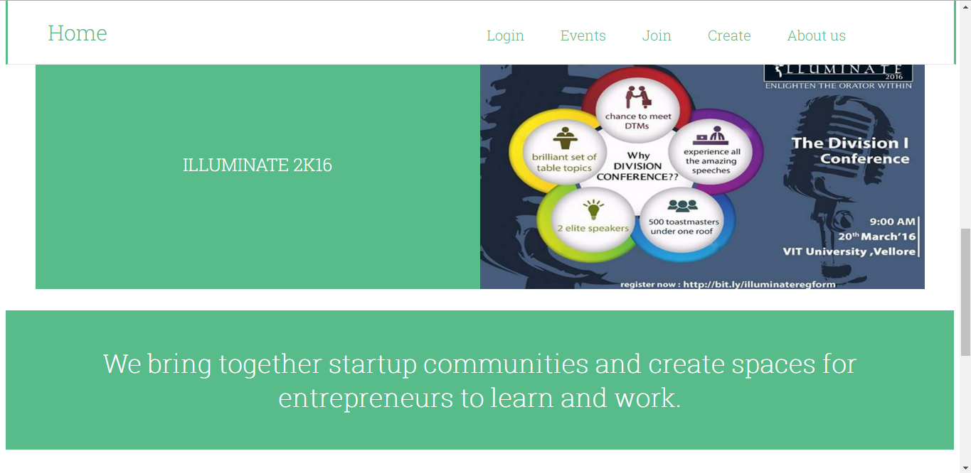

Slide 13
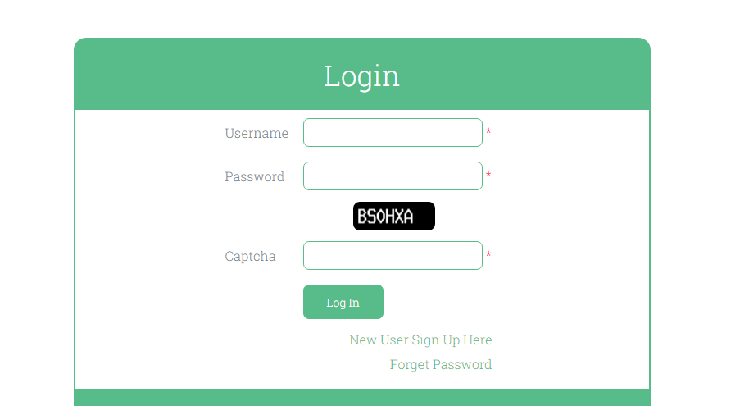

Slide 14
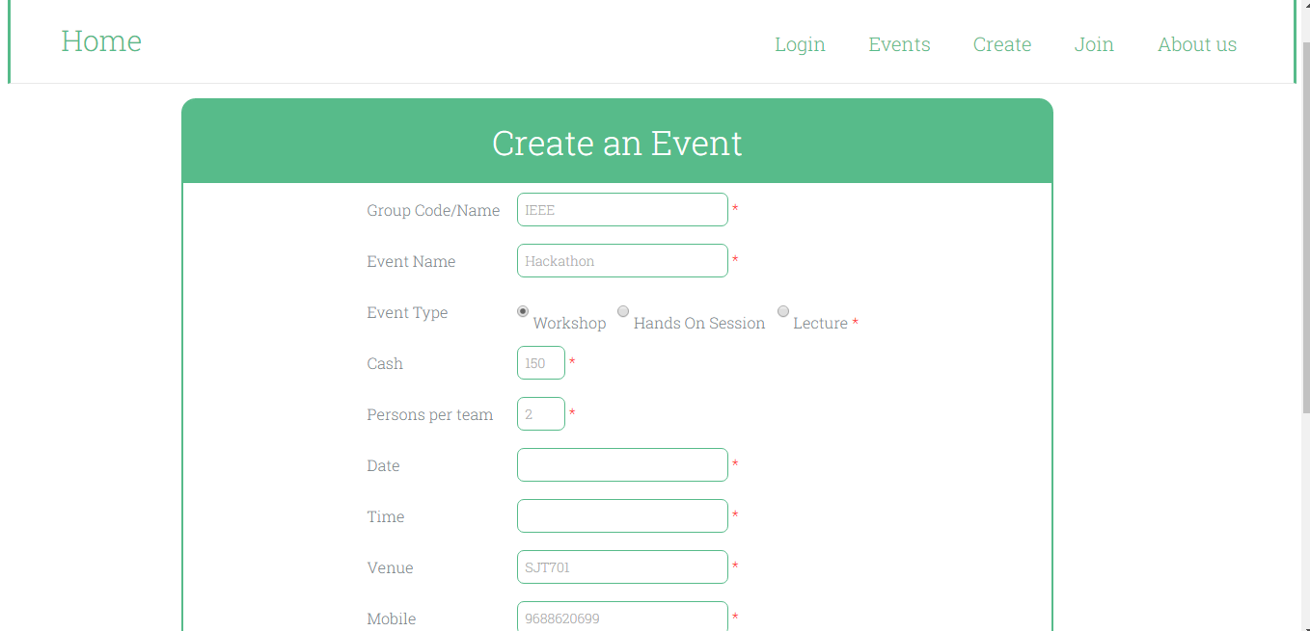

Slide 15
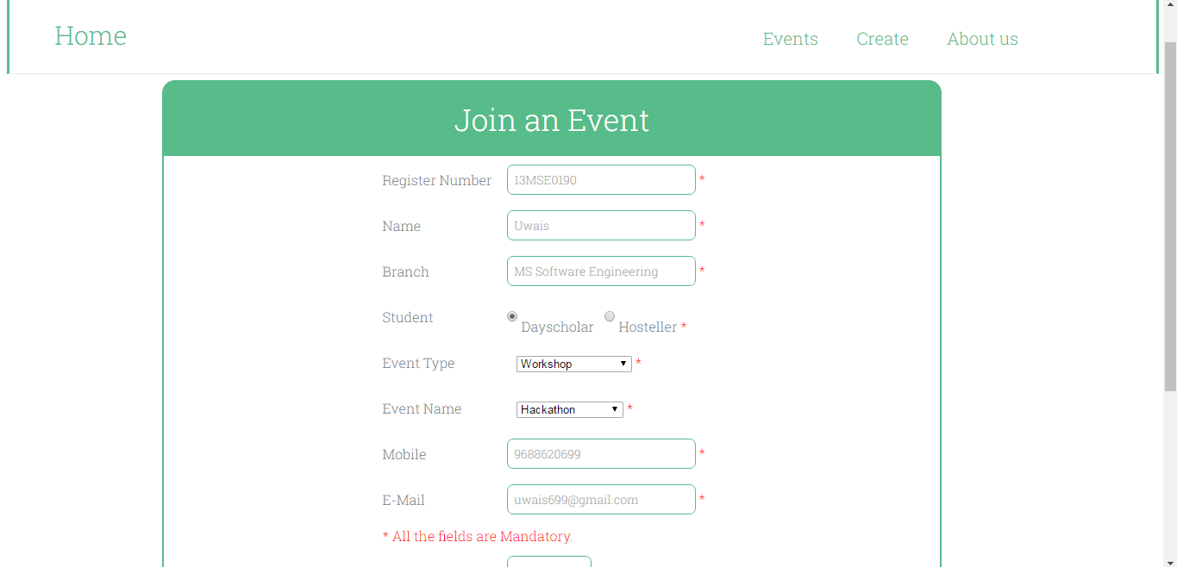

Slide 16
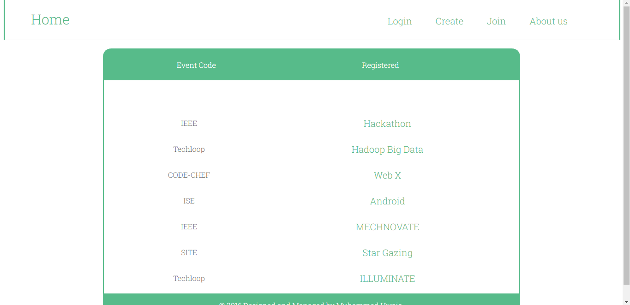

Slide 17
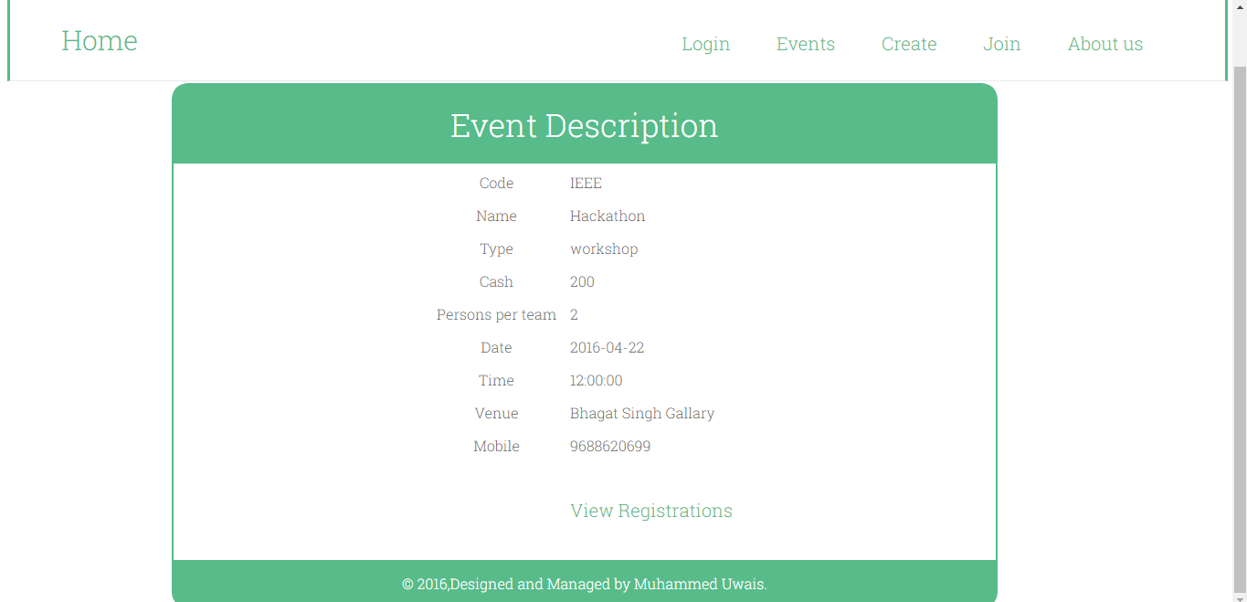

Slide 18
